Slide 1

There once was a grad from Collins Street,
Who needed foundations under their feet
They considered Deloitte, EY and PWC
However no grad program compared to KPMG
They followed their passion
And landed in a place with talent and compassion
No longer stuck in a rut
But soaring high like a bird in flight,
With a career that felt truly right…

Slide 2

KPMG - Perfect Start
Monash Innovation Guarantee 2023
Notes:
Welcome to the KPMG grad perfect start

Slide 3
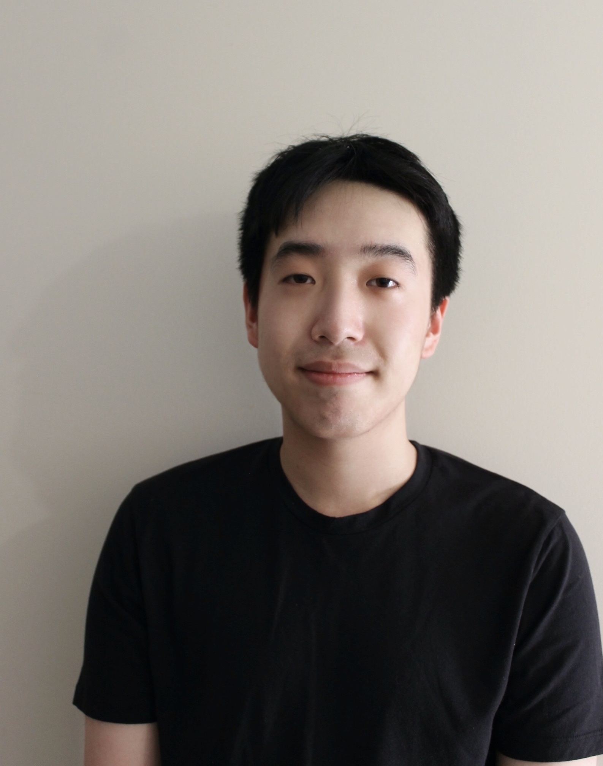
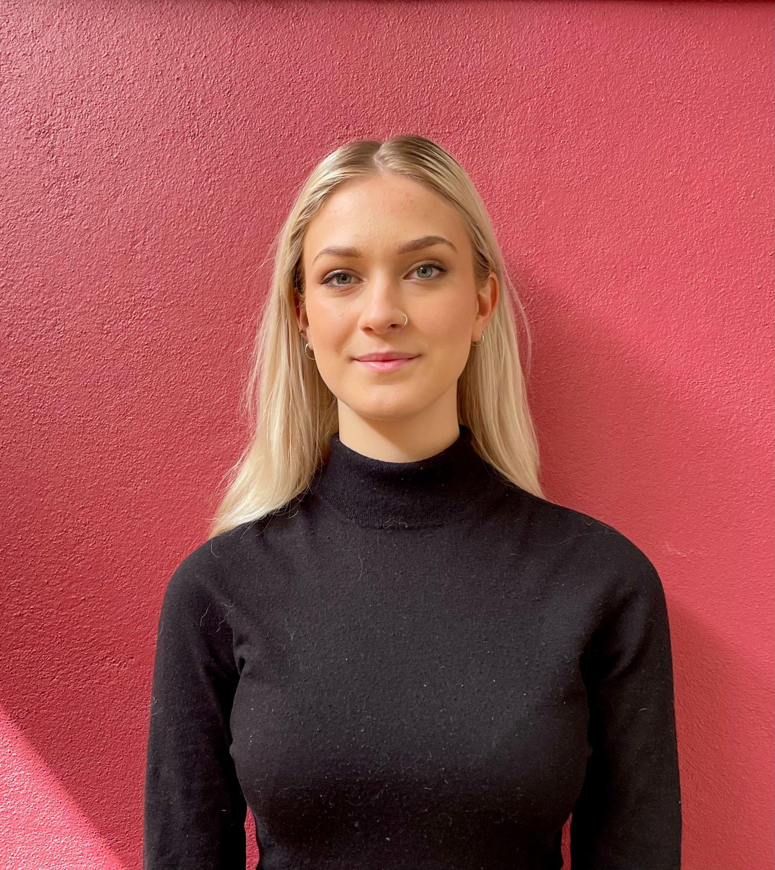
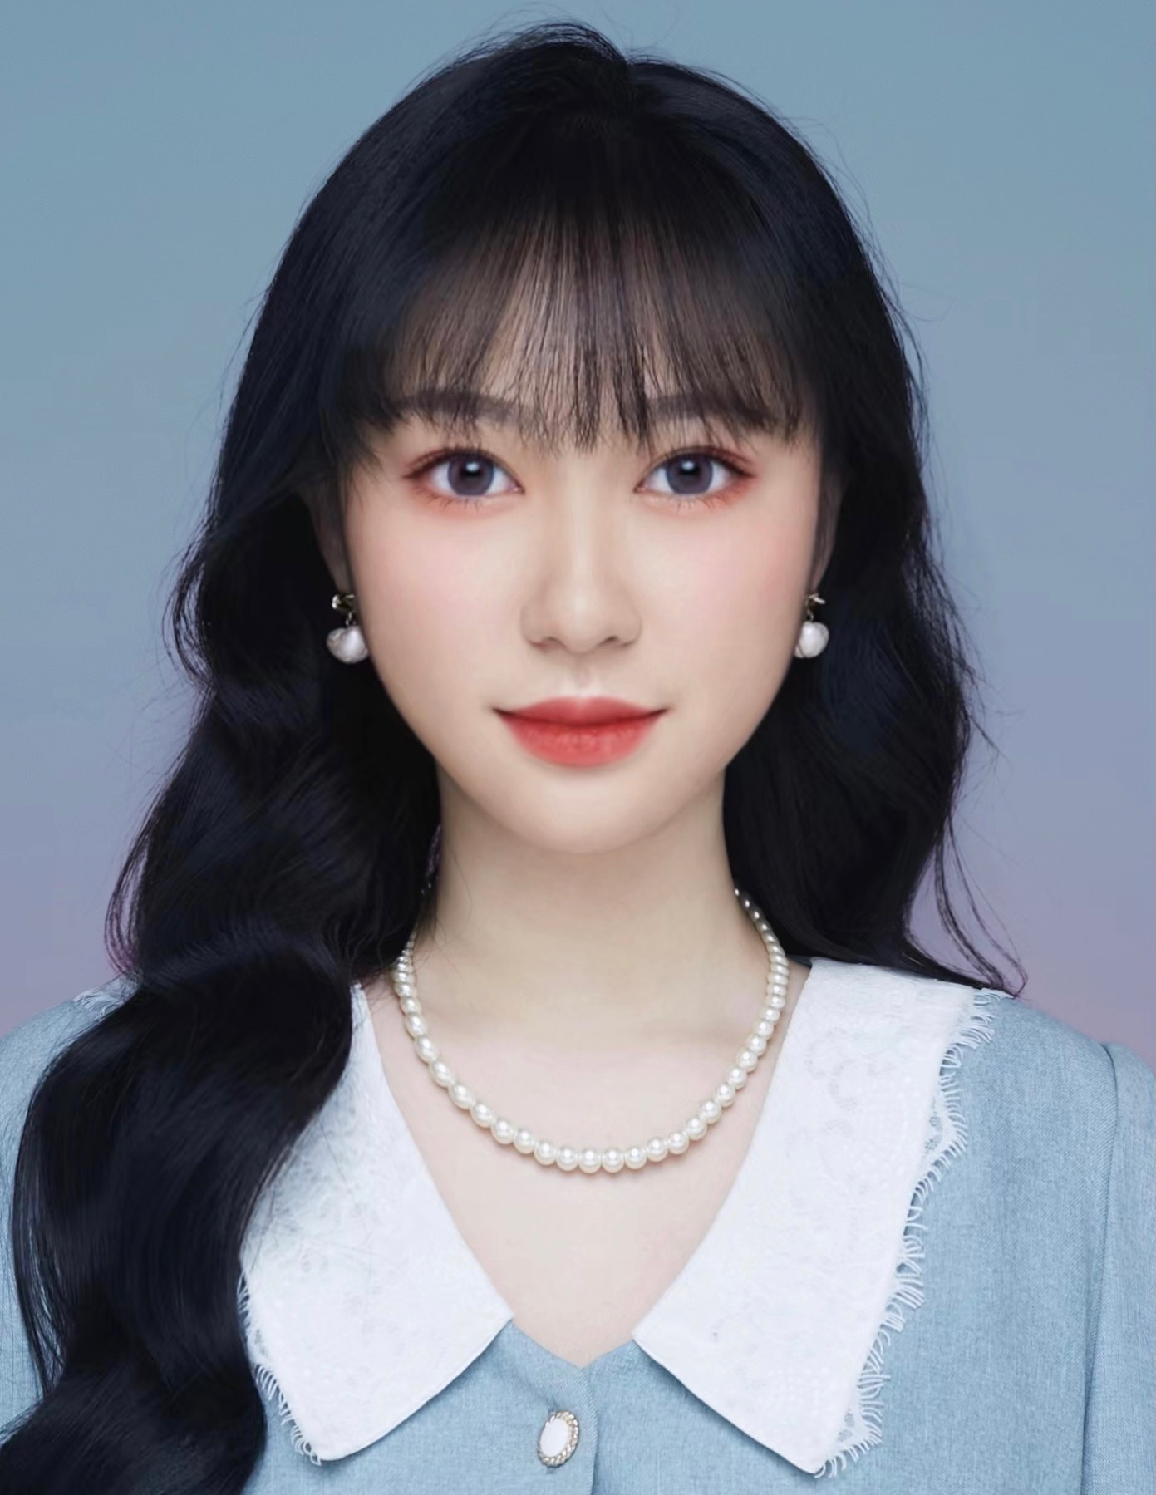
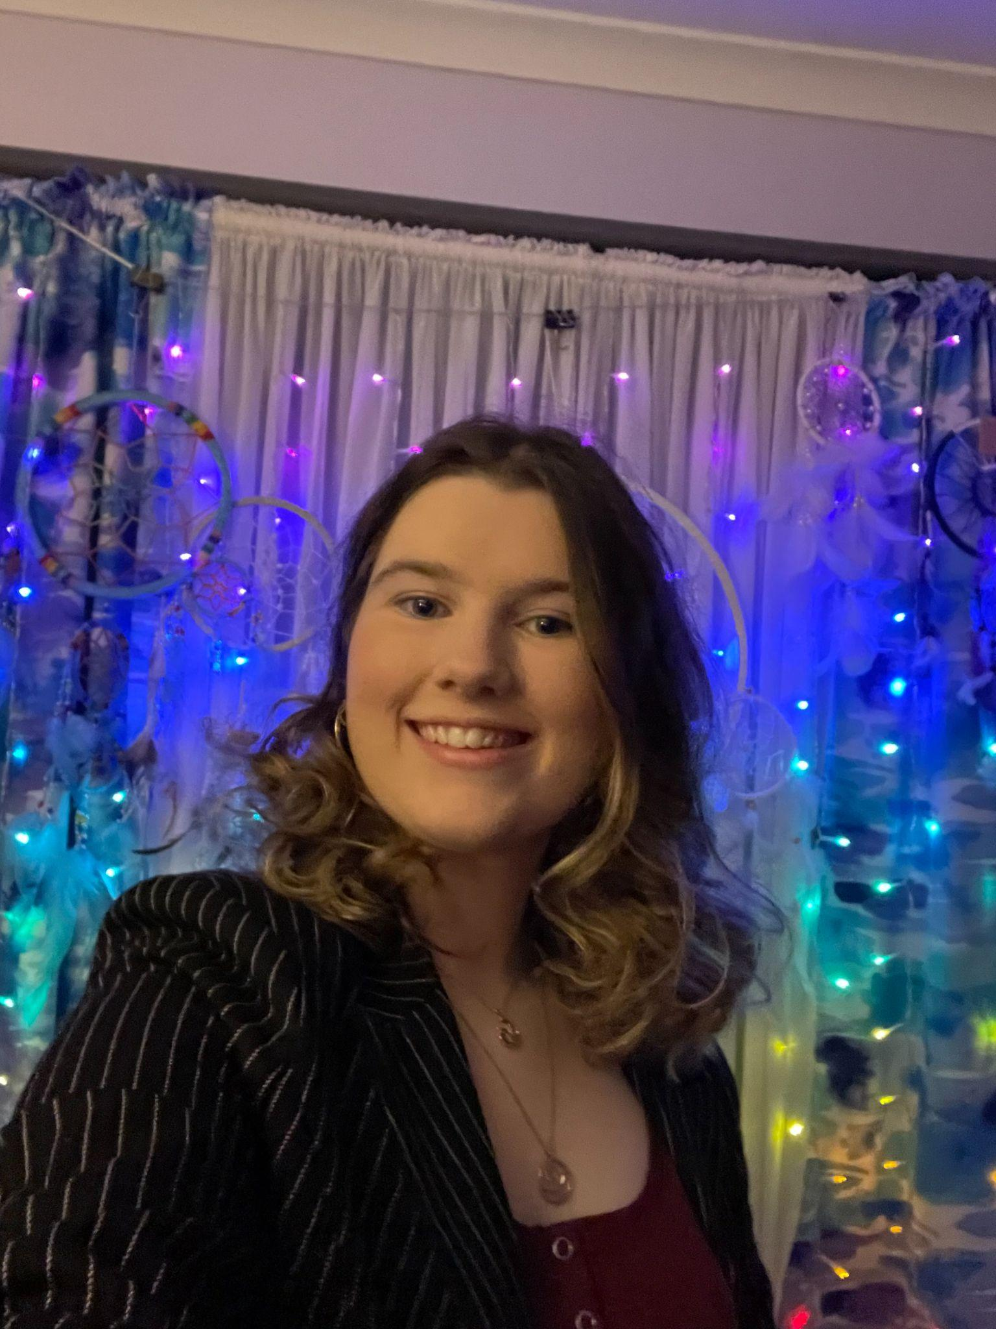
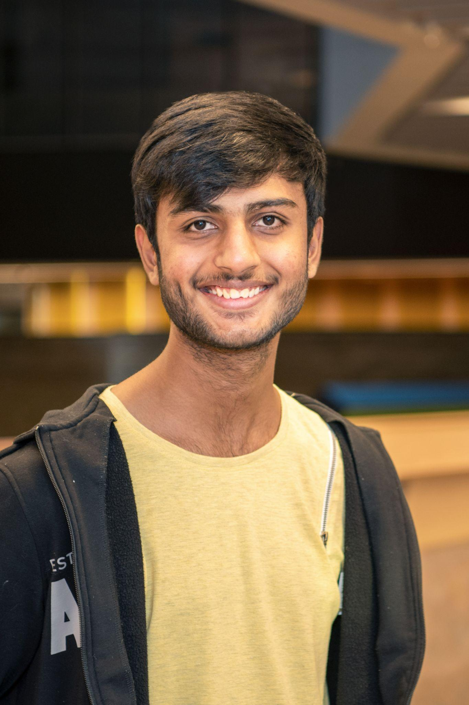
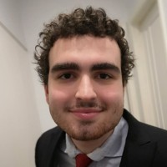
Meet the Team
Jackson Li
Lucinda Thorpe
Bachelor of Computer Science
and Commerce
Bachelor of Global Studies, specialising in IR
Yining Li
Bachelor of Business
Jacqueline East
Vedant Gadhavi
George Moutsos
Bachelor of Science and Law
Bachelor of Biomedical Science
Bachelor of Science

Slide 4

“What would the perfect first three months of a graduate program look like at KPMG?”
Notes:
The challenge set for us by KPMG was to design the perfect first three months for a graduate program at KPMG, which instantly appealed to us as soon to be graduates.

Slide 5
Focus Map
Creating positive social change
Graduate retention
Returns on program
UN SDGs
Graduates leave upskilled with a deep understanding of the company.
Team Building
Satisfied clients
Feasibility
It attracts diverse high performing graduates
Adapting to change
Alignment
to
company values
Distinguishing from the other Big 4
Contributing to the positive work culture
Notes:
When first tackling this challenge we wanted to visually break it down, assigning priority ranking to different features we brainstormed, and ultimately placing the most critical in the centre.
This left our focus on creating a feasible program that will attract diverse and high performing students that will leave feeling supskilled and have a deep knowledge of the KPMG business model.

Slide 6
Problem Diagram
Notes:
Taking our focus we further expanded this into a more detailed problem diagram exercising component of human centric design

Slide 7
Government
-KPMG works with the government, so having underskilled grads may result in important errors
Supportive program
-Guidance from experienced employees
Outcomes for Graduates
Clients
-Employees are skilled and leave the clients with a positive view of KPMG
Competitors
-Have competing grad programs
-Grads may be poached by other firms
Confident in their capabilities
Work/life balance
Resume building
-Transferable skills
-Reputable company
Stakeholders
Professional development -Upskilled graduates
Universities
-Pool of future graduates
-Place of advertising
-Uni’s can facilitate internships
What would the perfect first three months of a graduate program look like at a multidisciplinary professional organisation?
Investors
- A ‘Perfect Grad Program’ would increase the value of the company, and vice versa
Understanding of KPMG business model
-Understand bigger picture to avoid blinkers
Graduates
-Grads want a work/life balance
-Grads want to combat the cost of living crisis
-Want professional development
-Potential for career growth
Outcomes for KPMG
KPMG
-A poor graduate program will create underskilled employees
-Harm reputation
-Harm client relations
Currently, the program is performing okay, however it is not attracting high performing graduates
Well-rounded employees
-Experienced in different departments
Distinction from other ‘Big 4’
Notes:
This allowed us to investigate the crucial stakeholders and outcomes
Our key target demographic for the prototype is university graduates but KPMG and company extensions such as clients, are also significant for us to consider, as they are dependent upon the program and the employees that emerge.
From this we needed to consider the key outcomes desired for both parties, and used this to underpin the rationale for our prototype.

Slide 8
Government
-KPMG works with the government, so having underskilled grads may result in important errors
Supportive program
-Guidance from experienced employees
Outcomes for Graduates
Clients
-Employees are skilled and leave the clients with a positive view of KPMG
Competitors
-Have competing grad programs
-Grads may be poached by other firms
Confident in their capabilities
Work/life balance
Resume building
-Transferable skills
-Reputable company
Stakeholders
Professional development -Upskilled graduates
Universities
-Pool of future graduates
-Place of advertising
-Uni’s can facilitate internships
What would the perfect first three months of a graduate program look like at a multidisciplinary professional organisation?
Investors
- A ‘Perfect Grad Program’ would increase the value of the company, and vice versa
Understanding of KPMG business model
-Understand bigger picture to avoid blinkers
Graduates
-Grads want a work/life balance
-Grads want to combat the cost of living crisis
-Want professional development
-Potential for career growth
Outcomes for KPMG
KPMG
-A poor graduate program will create underskilled employees
-Harm reputation
-Harm client relations
Currently, the program is performing okay, however it is not attracting high performing graduates
Well-rounded employees
-Experienced in different departments
Distinction from other ‘Big 4’
Notes:
With a concentration placed on professional develop.

Slide 9
Storyboard
Notes:
From understanding our problem and where we were headed, we created a storyboard to visually see a potential progression of a graduate in our ideal program.

Slide 10
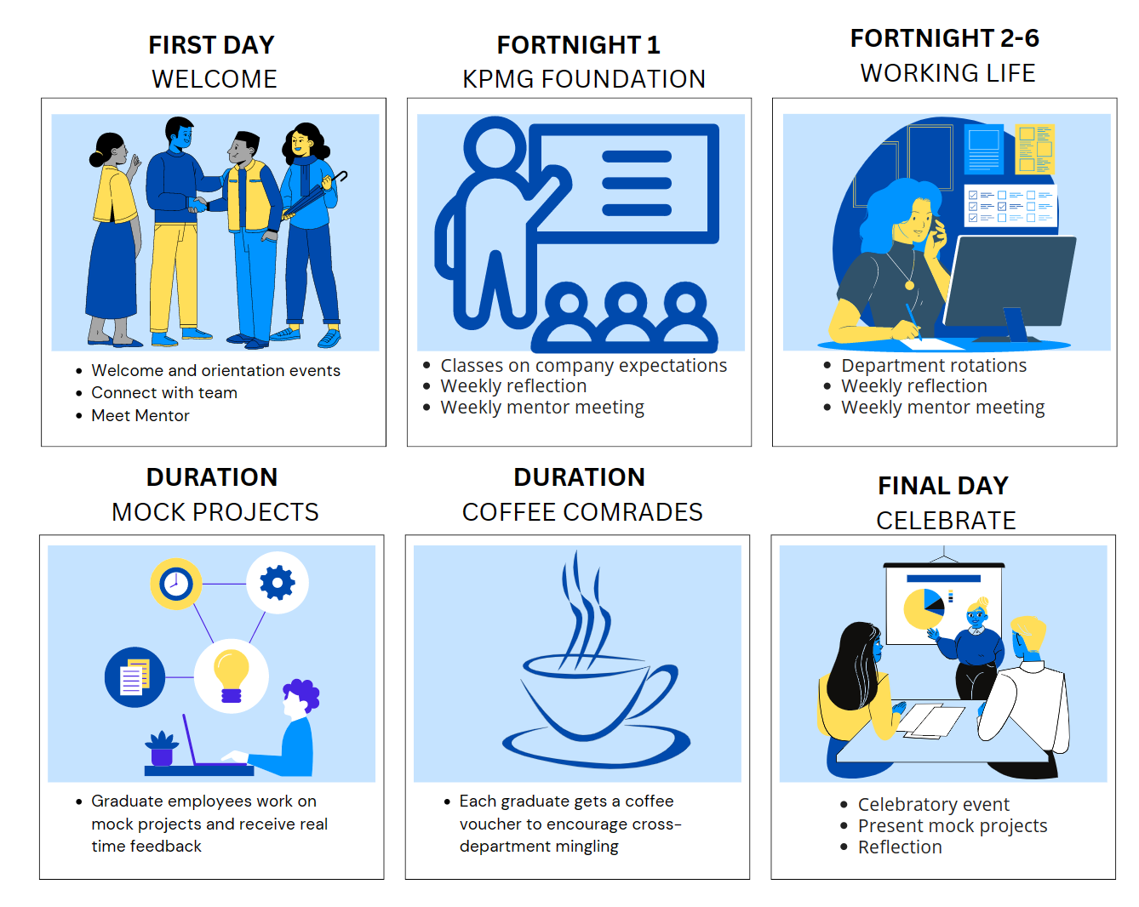
Notes:
Jacqui
A key feature we wanted to include was a smooth transition between university and professional work, whilst highlighting the bigger picture KPMG, ensuring graduates found their work engaging and meaningful.

Slide 11
Insights
Notes:
Now over to George to explain some further insights we gained through the sprint.
GEORGE TAKING INSIGHTS The insights we gained through our surveys and interviews with KPMG Grads informed our prototyping decisions

Slide 12
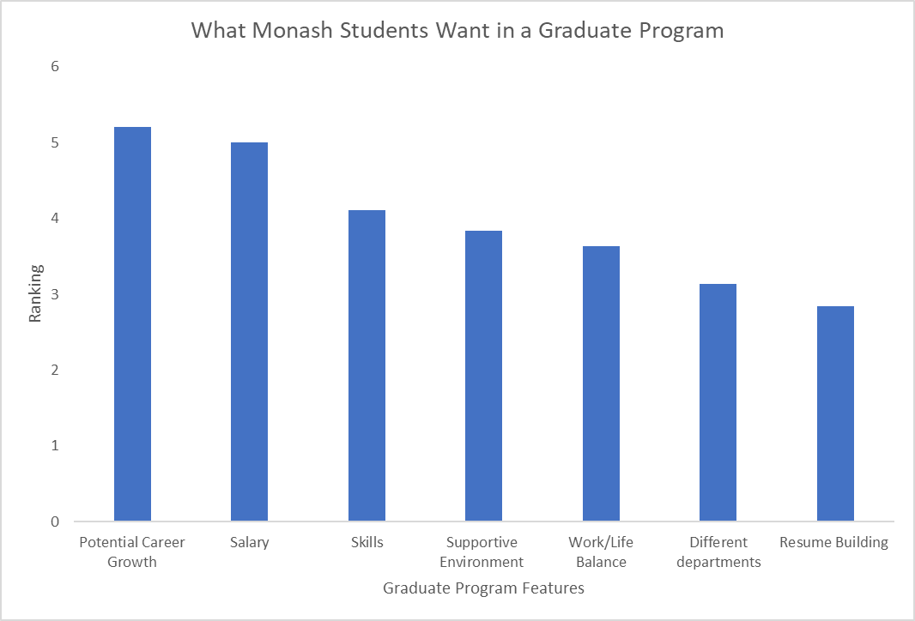
Notes:
During the program, we surveyed many Monash students about what they want in a graduate program (higher, the more desirable)
From the results, we can infer that career growth, total compensation and upskilling are the main features that students hope to gain from a graduate program.
This information assisted us to steer and design KPMG’s graduate program around the needs of both students and KPMG.

Slide 13

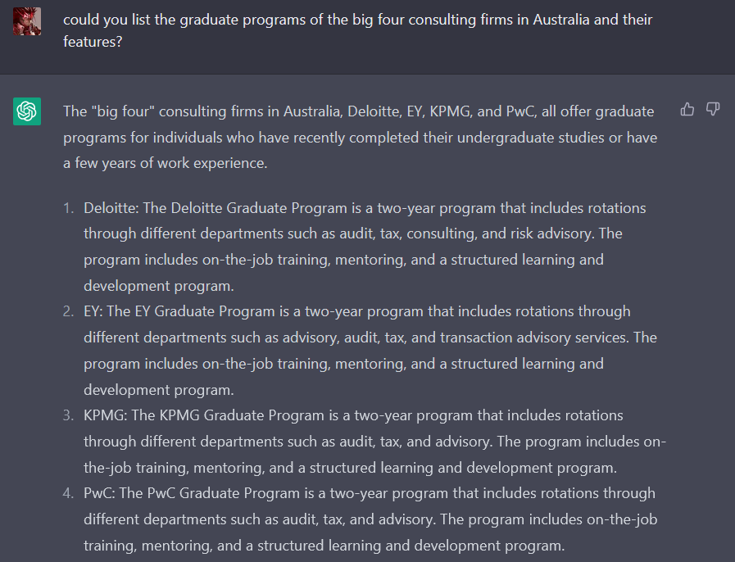
Artificial Intelligence
ChatGPT scans the entire internet
Results show no difference between the ‘Big 4’
Notes:
When we asked an AI bot to tell us about the Big 4 consulting companies the results were very telling.
ChatGPT scans the entire internet to form its databanks, which crafts its responses. Even this (near) all-knowing AI cannot meaningfully differentiate between the big four! We hope that this graduate program can become a point of difference for potential graduates.

Slide 14
Looking Back
Looking Forward
Social/team building opportunities
Interactive Q/A session in foundational classes
Recent graduate buddy
Longer rotation times
KPMG graduates largely enjoyed the program
KPMG graduates felt they had been thrown into the deep end
KPMG graduates wanted more learning opportunities

Slide 15
Prototype
Notes:
Our prototype is designed to be integrated to the current program, as according to our interview many grads enjoyed their time. We have left room for social events, and existing features such as the buddy system.

Slide 16
Part One -
Key Features

Slide 17

Mock Projects
Features
Supervised collaboration on mock projects
Continuous feedback
Rationale
Provide a safe and collaborative environment to build confidence and upskill (Young et al., 2014)
Implement techniques learnt on real projects in afternoon
Notes:
Graduates collaboratively working on past or imagined problems
Supervision from staff, roleplaying as clients and providing feedback on collaboration and problem solving skills
The classes will run in the mornings between fortnights 2-6

Slide 18

Mentorship
Features
Questionnaire used to match graduate to specific mentor aligning with aspirations and values
Weekly meeting
Rationale
Proven to be effective form of support and inspiration for corporations (Geary, 2023)
Notes:
Graduates will fill out a questionnaire about their aspirations and values
Results of the questionnaire will be used to pair them with a mentor in a position that aligns with the graduates’ interests
Graduates will touch base with their mentor on a weekly basis
Mentorship has proven to be very beneficial in corporate environments (Geary, 2023)
Rationale
Extend a hand of support from a senior staff member
Imbue a sense of inspiration and certainty in graduates

Slide 19

Coffee Comrades
Features
Coffee vouchers to encourage inter-department communication
Promote socialising and a holistic view of KPMG
Rationale
63% of younger employees value social interaction at work
Successful at ‘ThoughtWorks’ and ‘Lonely Planet’
Notes:
KPMG pays for a coffee for graduates to meet with a member from each department
A successful feature of graduates program at other companies ThoughtWorks and Lonely Planet
Promote social behaviour and a holistic understanding of the company
This will provide graduates with a point of contact from every department.

Slide 20

Department Rotations
Features
Graduates rotate through 4 departments for 3 weeks
Rationale
Holistic view of KPMG
Interdisciplinary graduate programs increase engagement (Newswander and Borrego 2009)
Notes:
Graduates select 5 out of the 10 departments to spend a fortnight working in
Shadowing members of the department and working on real problems with a team of experienced workers
Graduates will be placed in an environment in a failsafe environment
Rationale
Foster a sense of direction in graduates
Give a taste of what working the department would be and feel like
Provide graduates with points of contact in many departments

Slide 21

Foundational Classes
Features
Highlight principles of KPMG business model and company values
Q&A
Rationale
Provide a sense of direction/progression for work
Notes:
Provide an overview of KPMG’s principals and business model
Will make up the bulk of first fortnight of the graduate program
Rationale
Build critical knowledge and understanding of KPMG’s business model
Provide a sense of direction for graduates within the company

Slide 22

Elective Units
Features
Electives relating to wider issues and interests
e.g. climate change, social impact…
Rationale
Attract students from more varied backgrounds
Beneficial to student wellbeing (Deeg and May, 2021)
Notes:
Graduates will choose electives that interest them
Includes issues such as climate change, social impact, building interpersonal skills or dealing with conflict
Rationale
Empower graduates to follow their passions and upskill (as per our survey)
Attract driven graduates with strong values through a focus on positive social impact
This focus is beneficial for the wellbeing of graduates (Deeg and May, 2021).

Slide 23
Part Two -
What Would a Graduate’s Calendar Look Like in the First Three Months?

Slide 24
Weeks Prior
First Day
Week 1
Weeks 2-4
Mentor questionnaire
Nominate department rotation preferences
Clear and consistent information
Social Event
Weeks 5-7
Weeks 8-10
Weeks 10-13
Last Day
Notes:
Lucinda
The storyboard outlines what the google calender of what a graduates first three months on the program would be. This is one of the ways we have integrated human centred design into our challenge.
69% of PWC employees want a more fulfilling job (PricewaterhouseCoopers, 2022)
46% of the younger generation believe that burnout levels are too high so we have tried to conquer this with work days from 10:00-5:00 pm (Deloitte, 2022)
62% Gen Z see “relationship with peers” as one of the top 3 reasons for getting/keeping their jobs. We want to ensure the KPMG graduates receive opportunities to network and build a strong team dynamic. (McCrindle and Fell, n.d.)

Slide 25
Weeks Prior
First Day
Week 1
Weeks 2-4
Mentor questionnaire
Introduction to program & Expectations
Nominate department rotation preferences
Tour
Clear and consistent information
Company Lunch/ Network
Matched to mentor/buddy
Social Event
Weeks 5-7
Weeks 8-10
Weeks 10-13
Last Day
Notes:
Lucinda
The storyboard outlines what the google calender of what a graduates first three months on the program would be. This is one of the ways we have integrated human centred design into our challenge.
69% of PWC employees want a more fulfilling job (PricewaterhouseCoopers, 2022)
46% of the younger generation believe that burnout levels are too high so we have tried to conquer this with work days from 10:00-5:00 pm (Deloitte, 2022)
62% Gen Z see “relationship with peers” as one of the top 3 reasons for getting/keeping their jobs. We want to ensure the KPMG graduates receive opportunities to network and build a strong team dynamic. (McCrindle and Fell, n.d.)

Slide 26
Weeks Prior
First Day
Week 1
Weeks 2-4
Mentor questionnaire
Introduction to program & Expectations
Team Building
Nominate department rotation preferences
Foundational classes/modules
Tour
Company Lunch/ Network
Establish workplace expectations - culture, tech
Clear and consistent information
Matched to mentor/buddy
Social Event
Weeks 5-7
Weeks 8-10
Weeks 10-13
Last Day
Notes:
Lucinda
The storyboard outlines what the google calender of what a graduates first three months on the program would be. This is one of the ways we have integrated human centred design into our challenge.
69% of PWC employees want a more fulfilling job (PricewaterhouseCoopers, 2022)
46% of the younger generation believe that burnout levels are too high so we have tried to conquer this with work days from 10:00-5:00 pm (Deloitte, 2022)
62% Gen Z see “relationship with peers” as one of the top 3 reasons for getting/keeping their jobs. We want to ensure the KPMG graduates receive opportunities to network and build a strong team dynamic. (McCrindle and Fell, n.d.)

Slide 27
Weeks Prior
First Day
Week 1
Weeks 2-4
Mentor questionnaire
Introduction to program & Expectations
Team Building
Nominate department rotation preferences
Foundational classes/modules
Tour
Company Lunch/ Network
Establish workplace expectations - culture, tech
Clear and consistent information
Fortnightly Reflection
Fortnightly Reflection
Matched to mentor/buddy
Social Event
Weekly Mentor catch up
Weekly Mentor catch up
Weeks 5-7
Weeks 8-10
Weeks 10-13
Last Day
Fortnightly Reflection
Fortnightly Reflection
Fortnightly Reflection
Weekly Mentor catch up
Weekly Mentor catch up
Weekly Mentor catch up
Notes:
Lucinda
The storyboard outlines what the google calender of what a graduates first three months on the program would be. This is one of the ways we have integrated human centred design into our challenge.
69% of PWC employees want a more fulfilling job (PricewaterhouseCoopers, 2022)
46% of the younger generation believe that burnout levels are too high so we have tried to conquer this with work days from 10:00-5:00 pm (Deloitte, 2022)
62% Gen Z see “relationship with peers” as one of the top 3 reasons for getting/keeping their jobs. We want to ensure the KPMG graduates receive opportunities to network and build a strong team dynamic. (McCrindle and Fell, n.d.)

Slide 28
Weeks Prior
First Day
Week 1
Weeks 2-4
Mentor questionnaire
Introduction to program & Expectations
Team Building
Department Rotation 1
Nominate department rotation preferences
Foundational classes/modules
Tour
Company Lunch/ Network
Establish workplace expectations - culture, tech
Clear and consistent information
Fortnightly Reflection
Fortnightly Reflection
Matched to mentor/buddy
Social Event
Weekly Mentor catch up
Weekly Mentor catch up
Weeks 5-7
Weeks 8-10
Weeks 10-13
Last Day
Department Rotation 2
Department Rotation 3
Department Rotation 4
Fortnightly Reflection
Fortnightly Reflection
Fortnightly Reflection
Weekly Mentor catch up
Weekly Mentor catch up
Weekly Mentor catch up
Notes:
Lucinda
The storyboard outlines what the google calender of what a graduates first three months on the program would be. This is one of the ways we have integrated human centred design into our challenge.
69% of PWC employees want a more fulfilling job (PricewaterhouseCoopers, 2022)
46% of the younger generation believe that burnout levels are too high so we have tried to conquer this with work days from 10:00-5:00 pm (Deloitte, 2022)
62% Gen Z see “relationship with peers” as one of the top 3 reasons for getting/keeping their jobs. We want to ensure the KPMG graduates receive opportunities to network and build a strong team dynamic. (McCrindle and Fell, n.d.)

Slide 29
Weeks Prior
First Day
Week 1
Weeks 2-4
Mentor questionnaire
Introduction to program & Expectations
Team Building
Department Rotation 1
Nominate department rotation preferences
Foundational classes/modules
Elective classes/mock projects
Tour
Company Lunch/ Network
Establish workplace expectations - culture, tech
Clear and consistent information
Fortnightly Reflection
Fortnightly Reflection
Matched to mentor/buddy
Social Event
Weekly Mentor catch up
Weekly Mentor catch up
Weeks 5-7
Weeks 8-10
Weeks 10-13
Last Day
Department Rotation 2
Department Rotation 3
Department Rotation 4
Elective classes/mock projects
Elective classes/mock projects
Elective classes/mock projects
Fortnightly Reflection
Fortnightly Reflection
Fortnightly Reflection
Weekly Mentor catch up
Weekly Mentor catch up
Weekly Mentor catch up
Notes:
Lucinda
The storyboard outlines what the google calender of what a graduates first three months on the program would be. This is one of the ways we have integrated human centred design into our challenge.
69% of PWC employees want a more fulfilling job (PricewaterhouseCoopers, 2022)
46% of the younger generation believe that burnout levels are too high so we have tried to conquer this with work days from 10:00-5:00 pm (Deloitte, 2022)
62% Gen Z see “relationship with peers” as one of the top 3 reasons for getting/keeping their jobs. We want to ensure the KPMG graduates receive opportunities to network and build a strong team dynamic. (McCrindle and Fell, n.d.)

Slide 30
Weeks Prior
First Day
Week 1
Weeks 2-4
Mentor questionnaire
Introduction to program & Expectations
Team Building
Department Rotation 1
Nominate department rotation preferences
Foundational classes/modules
Elective classes/mock projects
Tour
Company Lunch/ Network
Establish workplace expectations - culture, tech
Department placement
Clear and consistent information
Fortnightly Reflection
Fortnightly Reflection
Matched to mentor/buddy
Social Event
Weekly Mentor catch up
Weekly Mentor catch up
Weeks 5-7
Weeks 8-10
Weeks 10-13
Last Day
Department Rotation 2
Department Rotation 3
Department Rotation 4
Elective classes/mock projects
Elective classes/mock projects
Elective classes/mock projects
Department placement
Department placement
Department placement
Fortnightly Reflection
Fortnightly Reflection
Fortnightly Reflection
Weekly Mentor catch up
Weekly Mentor catch up
Weekly Mentor catch up
Notes:
Lucinda
The storyboard outlines what the google calender of what a graduates first three months on the program would be. This is one of the ways we have integrated human centred design into our challenge.
69% of PWC employees want a more fulfilling job (PricewaterhouseCoopers, 2022)
46% of the younger generation believe that burnout levels are too high so we have tried to conquer this with work days from 10:00-5:00 pm (Deloitte, 2022)
62% Gen Z see “relationship with peers” as one of the top 3 reasons for getting/keeping their jobs. We want to ensure the KPMG graduates receive opportunities to network and build a strong team dynamic. (McCrindle and Fell, n.d.)

Slide 31
Weeks Prior
First Day
Week 1
Weeks 2-4
Mentor questionnaire
Introduction to program & Expectations
Team Building
Department Rotation 1
Nominate department rotation preferences
Foundational classes/modules
Elective classes/mock projects
Tour
Company Lunch/ Network
Establish workplace expectations - culture, tech
Department placement
Clear and consistent information
Fortnightly Reflection
Fortnightly Reflection
Matched to mentor/buddy
Social Event
Weekly Mentor catch up
Weekly Mentor catch up
Weeks 5-7
Weeks 8-10
Weeks 10-13
Last Day
Department Rotation 2
Department Rotation 3
Department Rotation 4
Showcase mock project solutions to senior staff
Elective classes/mock projects
Elective classes/mock projects
Elective classes/mock projects
Finalise placements /departments for next step of grad journey
Department placement
Department placement
Department placement
Fortnightly Reflection
Fortnightly Reflection
Fortnightly Reflection
Celebratory event
Weekly Mentor catch up
Weekly Mentor catch up
Weekly Mentor catch up
Notes:
Lucinda
The storyboard outlines what the google calender of what a graduates first three months on the program would be. This is one of the ways we have integrated human centred design into our challenge.
69% of PWC employees want a more fulfilling job (PricewaterhouseCoopers, 2022)
46% of the younger generation believe that burnout levels are too high so we have tried to conquer this with work days from 10:00-5:00 pm (Deloitte, 2022)
62% Gen Z see “relationship with peers” as one of the top 3 reasons for getting/keeping their jobs. We want to ensure the KPMG graduates receive opportunities to network and build a strong team dynamic. (McCrindle and Fell, n.d.)

Slide 32
And so the grad left capable
Orientated, brave and unshakable
They would go on to do great
And soar high as was their fate
The grad program at KPMG was a work of art
It gave us the perfect start
Notes:
To take us back to our graduate they left capable…
-emphasis on ‘us’ maybe to bring it back to the fact were the ones they targeting

Slide 33
Bibliography
Australian Bureau of Statistics (2021). Job mobility, February 2021 | Australian Bureau of Statistics. [online] www.abs.gov.au. Available at: https://www.abs.gov.au/statistics/labour/jobs/job-mobility/latest-release.
(2023) https://openai.com/blog/chatgpt/
Deeg, M.D. and May, D.R. (2021). The Benefits to the Human Spirit of Acting Ethically at Work: The Effects of Professional Moral Courage on Work Meaningfulness and Life Well-Being. Journal of Business Ethics, 181(2). doi:10.1007/s10551-021-04980-4.
Deloitte (2022). The Deloitte Global 2022 Gen Z and Millennial Survey | Deloitte Global. [online] www.deloitte.com. Available at: https://www.deloitte.com/global/en/issues/work/genzmillennialsurvey.html.
Geary, A. (2023). Seismic Soundoff: the Necessity and Benefits of Mentorship. The Leading Edge, 42(1), pp.80–80. doi:10.1190/tle42010080.1.
Newswander, L.K., Borrego, M. Engagement in two interdisciplinary graduate programs. High Educ 58, 551–562 (2009). https://doi.org/10.1007/s10734-009-9215-z
McCrindle, M. and Fell, A. (n.d.). R EC RU I T I N G, T R A I N I N G A N D L E A D I N G T H E N E XT G E N E R AT I O N. [online] Available at: https://generationz.com.au/wp-content/uploads/2019/12/Understanding_Generation_Z_report_McCrindle.pdf.
Michelle R. Simpson,Engagement at work: A review of the literature, International Journal of Nursing Studies,Volume 46, Issue 7, 2009,Pages, 1012-1024,https://doi.org/10.1016/j.ijnurstu.2008.05.003.
(https://www.sciencedirect.com/science/article/pii/S0020748908001454)
PricewaterhouseCoopers (2022). Survey of over 52,000 workers indicates the Great Resignation is set to continue as pressure on pay mounts. [online] PwC. Available at: https://www.pwc.com/gx/en/news-room/press-releases/2022/global-workforce-hopes-and-fears-survey-2022.html.
Young, I., Montgomery, K., Kearns, P., Hayward, S. and Mellaby, E. (2014), The benefits of a peer-assisted mock OSCE. Clin Teach, 11: 214-218. https://doi.org/10.1111/tct.12112

